Slide 1


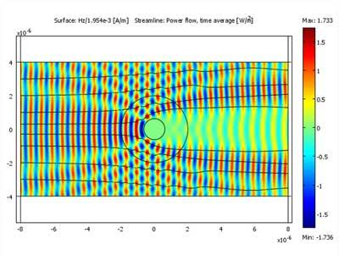
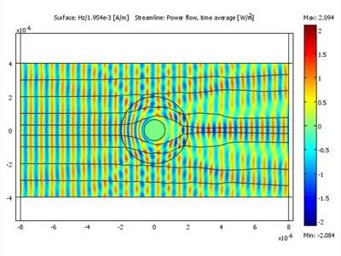
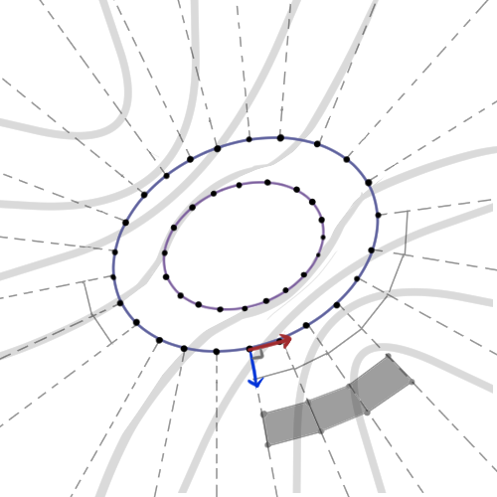
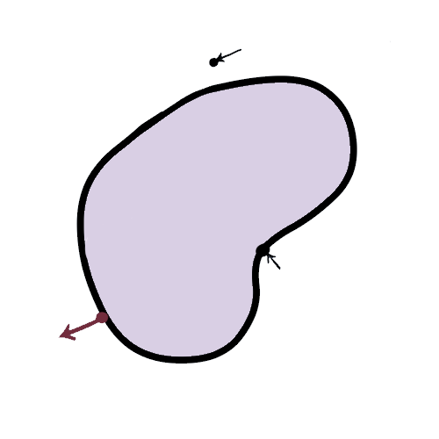

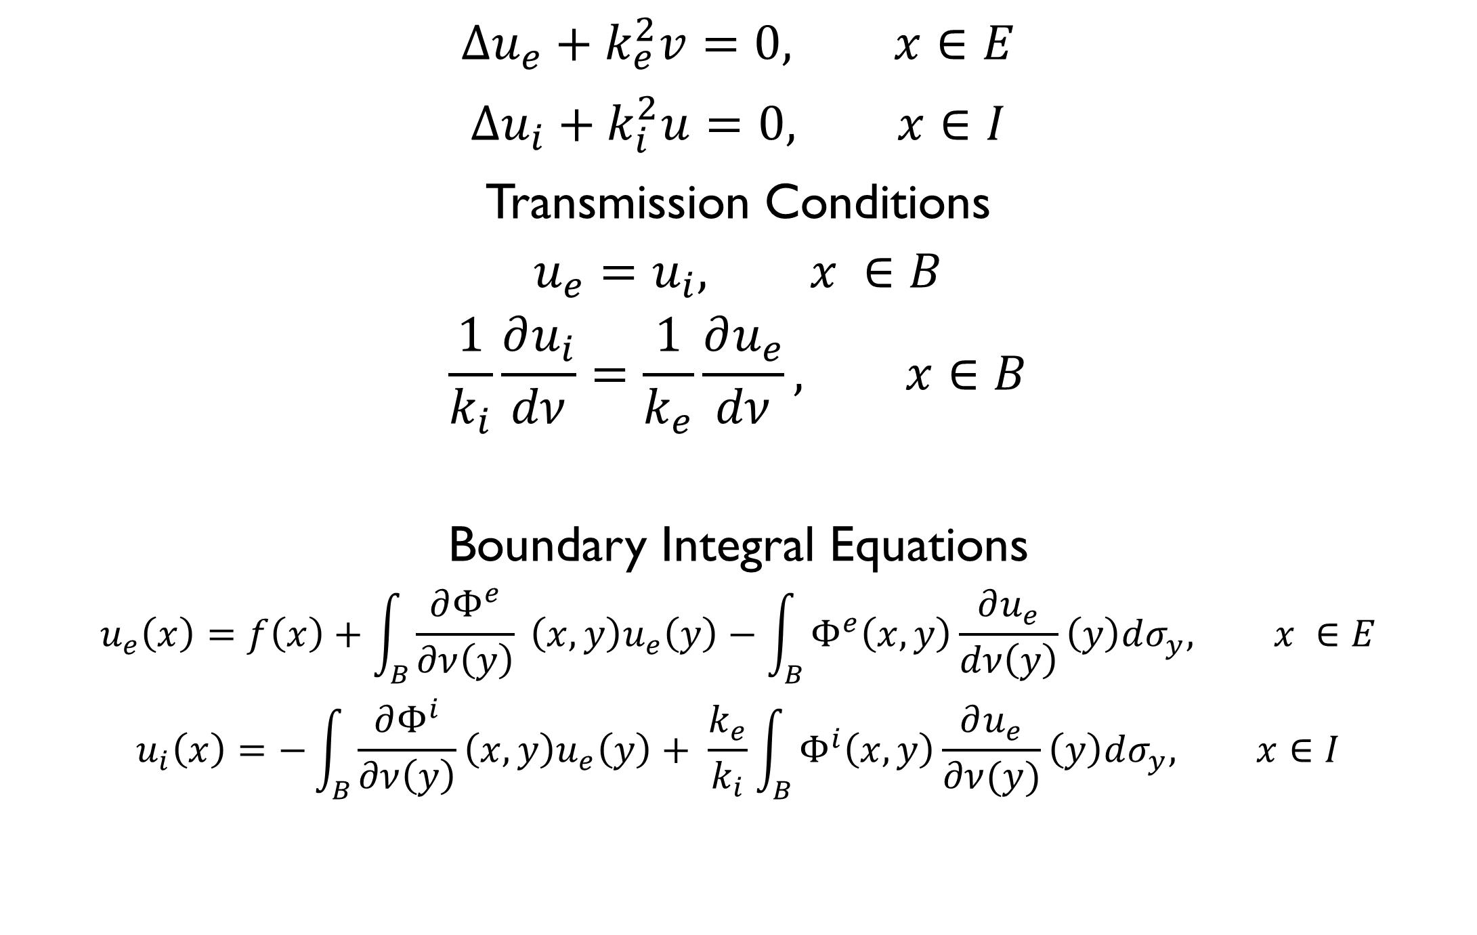

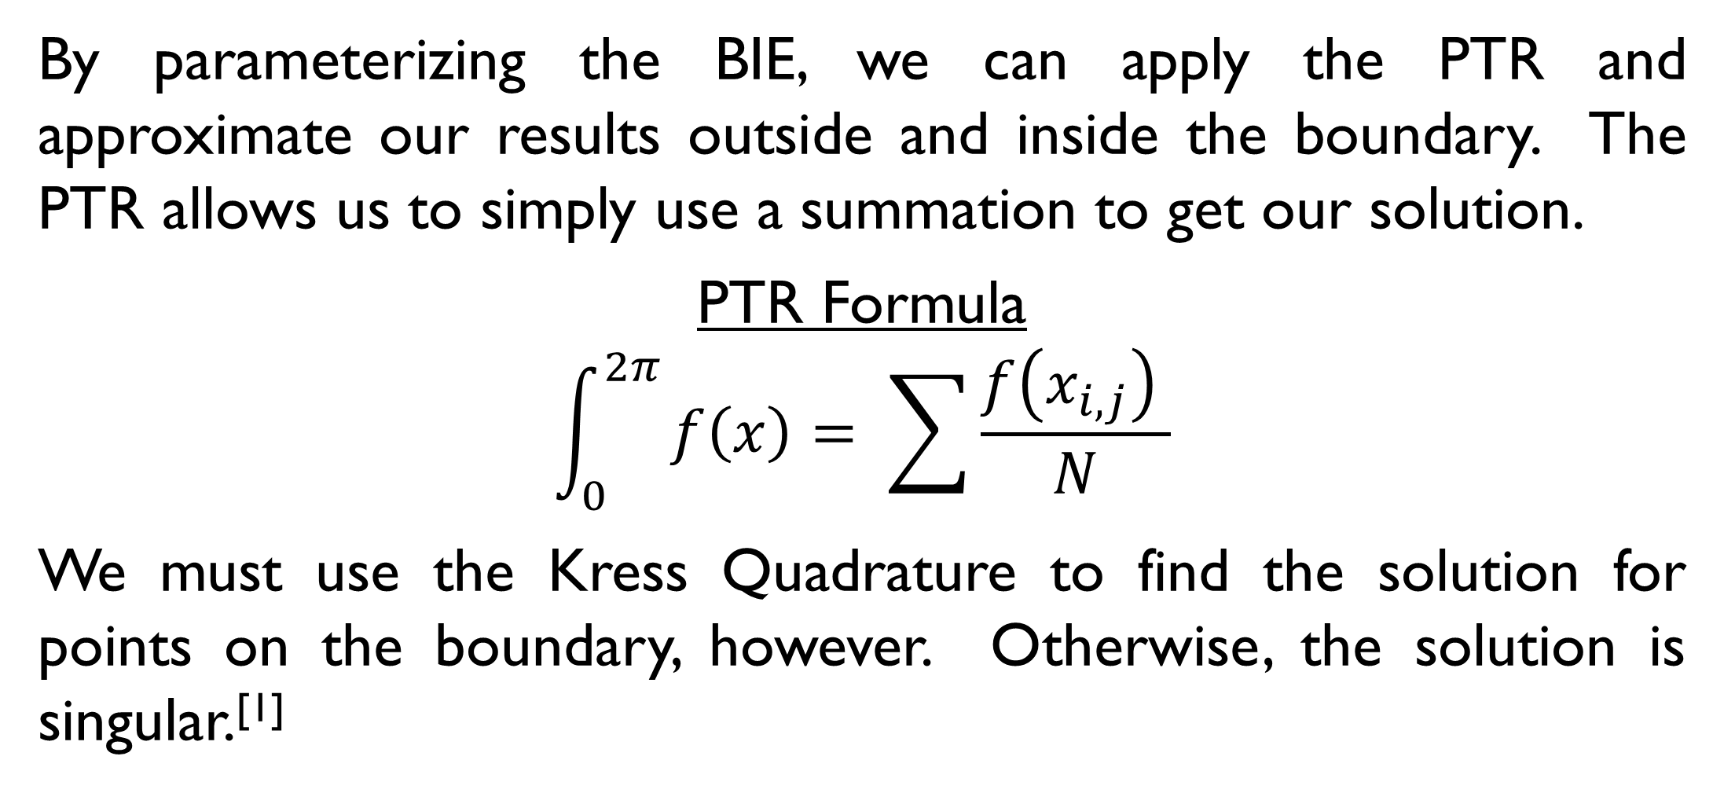




Cloaking using Periodic Trapezoid Rule Approximation of Boundary Integrals
E. A. Cortes, C. Carvalho, School of Natural Sciences, University of California, Merced
Introduction
Numerical Method
Transmission
Our goal is to simulate optical cloaking devices by calculating how light travels through defined boundaries. Optical cloaking refers to the act of making something invisible in some directions by preventing the scattering of light as it hits the boundary. Cloaking is often seen in science fiction, but also has real-world applications for radar and military science.
We use boundary integral equation methods to compute the solution in layered boundaries, and we implement in Python an approximation using the periodic trapezoid rule and the Kress Quadrature.^{[1]}
By parameterizing the BIE, we can apply the PTR and approximate our results outside and inside the boundary. The PTR allows us to simply use a summation to get our solution.
PTR Formula
$$\int_{0}^{2π}{f\left(x\right)= \sum{\frac{f\left(x_{i,j}\right) }{N}}}$$
We must use the Kress Quadrature to find the solution for points on the boundary, however. Otherwise, the solution is singular.^{[1]}
Figure 2. The PTR is used to fill in a grid originating from selected points on the boundary. This method reduces the amount of points which must be evaluated to simulate the behavior of a source acting on the boundary.
Figure 1. The scattering of light on an uncloaked object (left) versus that of a cloaked object (right).^{[4]}
Transmission Problem
Validation
Conclusion
$$x= <x_{1},x_{2}>$$
Data $f$
Solution $u_{e}$
B
E
I
Solution $u_{i}$
$$ν$$
$$y= <y_{1},y_{2}>$$
$$∆u_{e}+k_{e}^{2}v=0, x∈E$$
$$∆u_{i}+k_{i}^{2}u=0, x∈I$$
Transmission Conditions
$$u_{e}=u_{i}, x ∈B$$
$$\frac{1}{k_{i}}\frac{∂u_{i}}{dν}=\frac{1}{k_{e}}\frac{∂u_{e}}{dν}, x∈B$$
Boundary Integral Equations
$$u_{e}\left(x\right)=f\left(x\right)+\int_{B}{\frac{∂Φ^{e}}{∂ν\left(y\right)}} \left(x, y\right)u_{e}\left(y\right)−\int_{B}{Φ^{e}\left(x,y\right)\frac{∂u_{e}}{dν\left(y\right)}\left(y\right)dσ_{y}, x ∈E}$$
$$u_{i}\left(x\right)=−\int_{B}{\frac{∂Φ^{i}}{∂ν\left(y\right)}\left(x, y\right)u_{e}\left(y\right)+ \frac{k_{e}}{k_{i}}\int_{B}{Φ^{i}\left(x,y\right)\frac{∂u_{e}}{∂ν(y)}\left(y\right)dσ_{y}, x∈I}}$$

